Slide 1
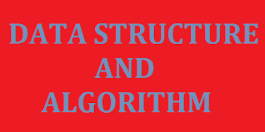

Slide 2
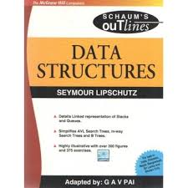
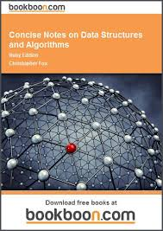
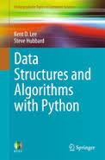
Related books

Slide 3
Introduction
Data- values or set values
Data item- single unit of values
Group items- data items that can be divided into subitems. E.g Name
Elementary items- data items that cannot be divided into subitems. E.g Phone number
Information- Meaningful or processed data

Slide 4
Cont…
Entity- something that has certain attributes/properties which my be assignned values
Entity set- collection of entities with similar attributes
Attributes | Name | Age | Sex | Reg. Number
Values | Musa Isa | 18 | M | CST/14/00123

Slide 5
Cont…
Field- a single elementary unit of information representing an attribute of an entity
Record- collection of field values of a given entity
File- collection of records of the entities in a given entity set

Slide 6
Cont…
Primary key- a field that uniquely determines a record in a file
example
Level coordination
Keeps students’ files
Each file contains student’s record
Each record is made up of fields, e.g name,
Records are sorted according to a key

Slide 7
Cont…
Fixed-length record: Same data items with same amount of space assigned to each data item
Variable-length record: different data and length
example
Students’ course registration
Fresh and returning

Slide 8
Data structures?
Logical and mathematical model of a particular organization of data
Data Structure is a way of collecting and organising data in such a way that we can perform operations on these data in an effective way

Slide 9
Classification of Data structures
Primitive data structures- Basic data types such as integer, real, character, and boolean
Non-primitive data structures: Complex data structures used to store large and connected data. Examples include Linked list, stacks, queues, trees and graphs.

Slide 10
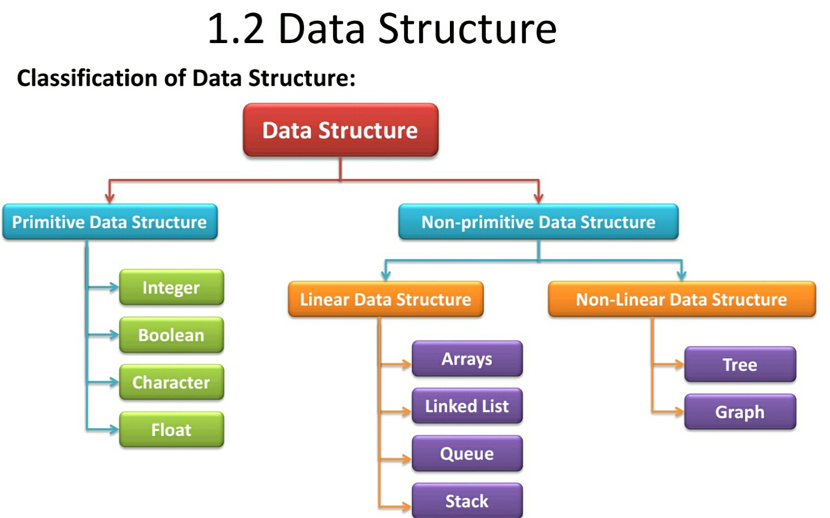

Slide 11
Linear and Non-linear data structure
Linear – elements form a sequence/ linear list
example- arrays, linked-list, stacks and queues
non-linear: data/elements not arranged in sequence
example- Trees and graphs

Slide 12
Linear Data Structure
A data structure is said to be linear if its elements form any sequence.
The common examples of linear data structure are
- Arrays
- Linked lists
- Stack
- Queues

Slide 13
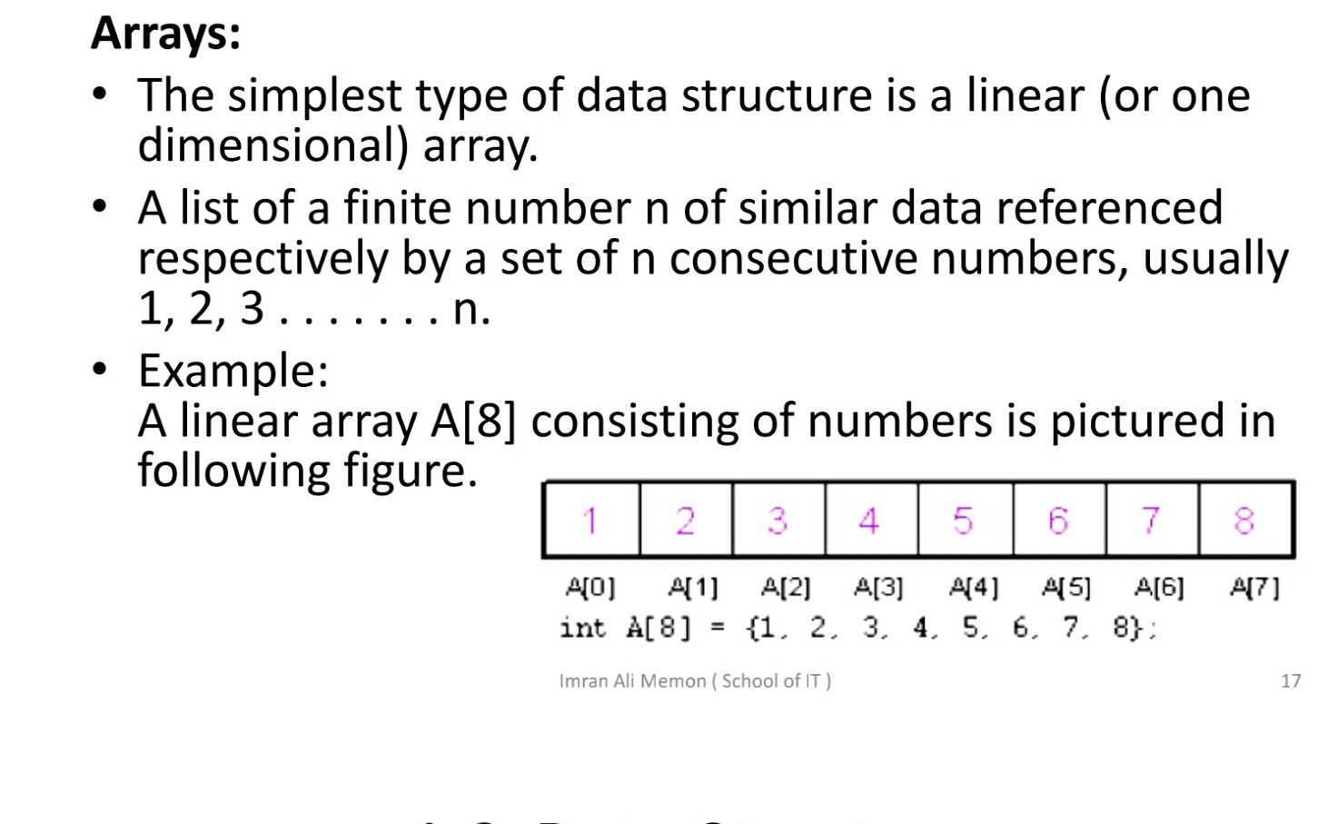

Slide 14
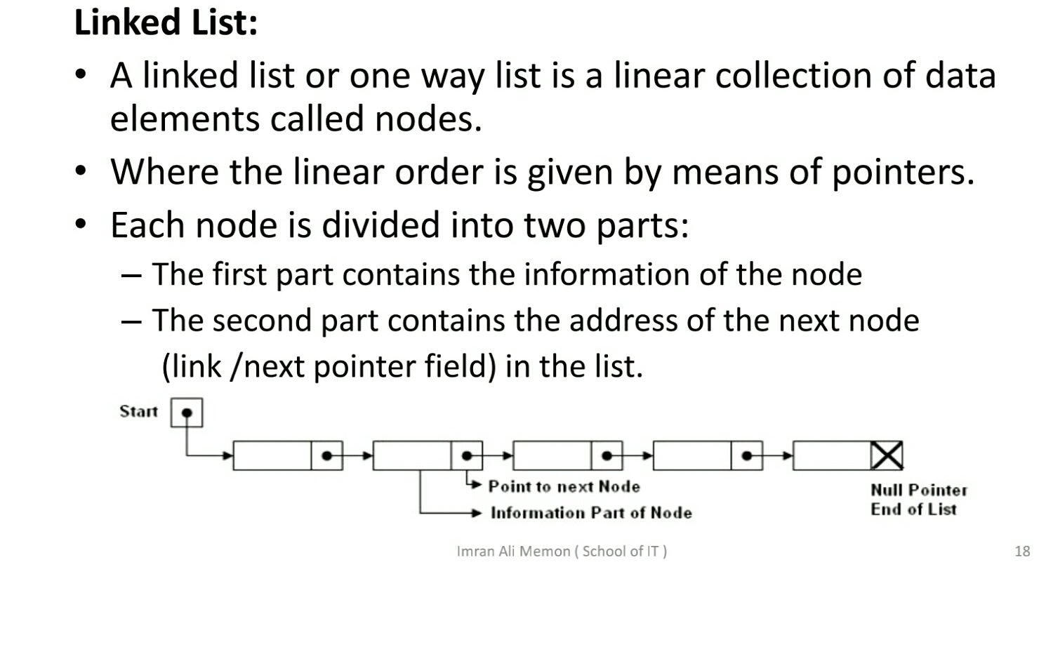

Slide 15
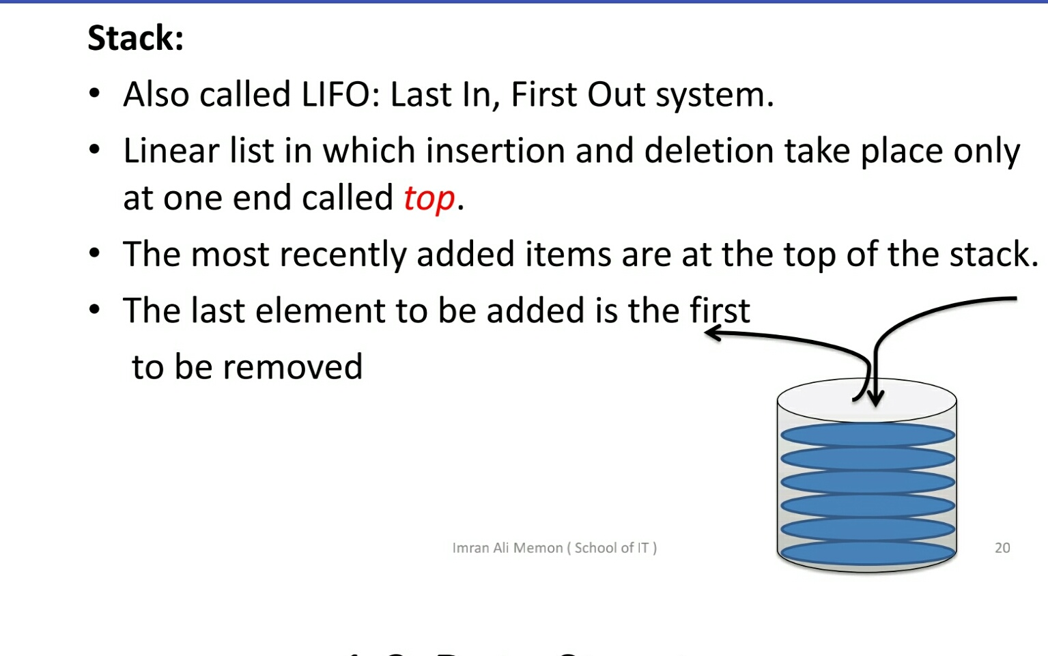

Slide 16
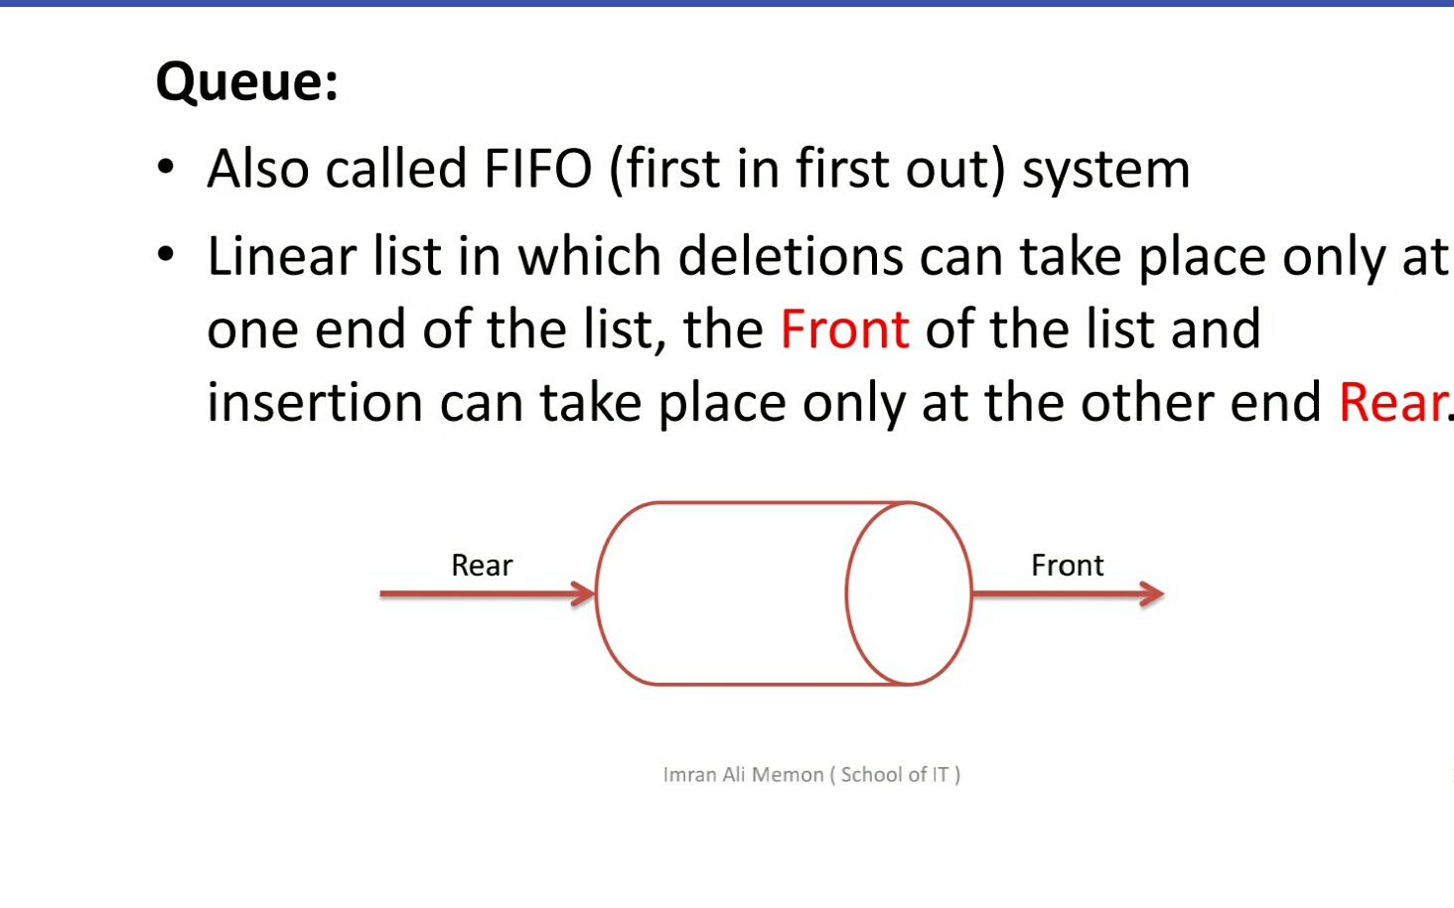

Slide 17
Non-Linear Data Structure
This structure is mainly used to represent data containing a hierarchical relationship between elements.
The common examples of non-linear data structure are
-Tree
-Graph

Slide 18
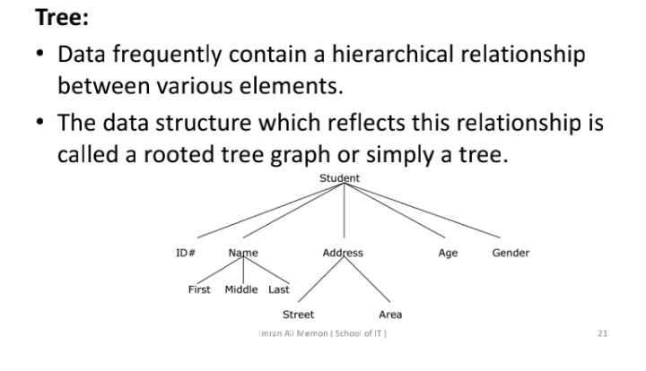

Slide 19
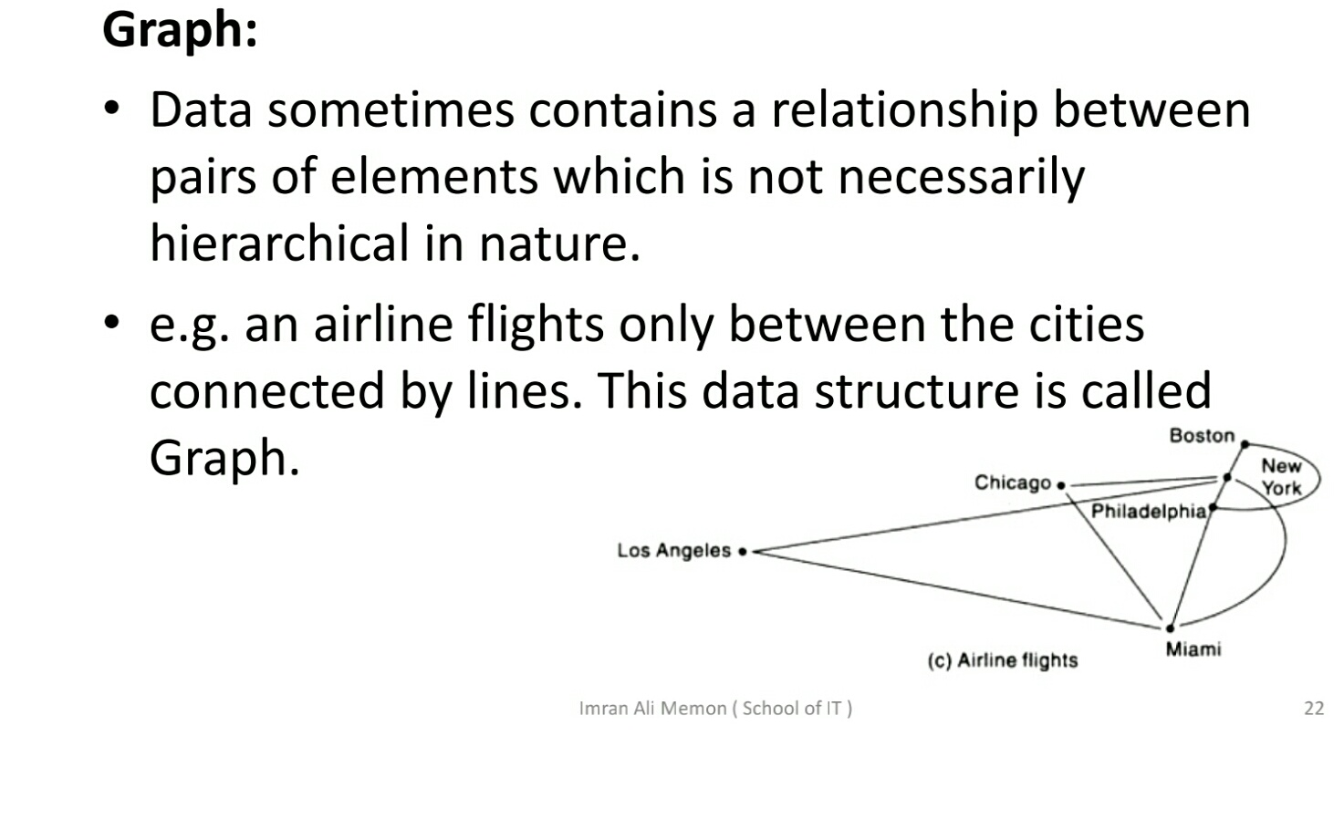

Slide 20
Data structures operations
Traversing
Searching
Inserting
Deleting
Sorting
merging

Slide 21
Algorithms
A well defined list of steps for solving a particular problem
Example: Sorting data in ascending order.
Problem: Sorting
Problem Instance: e.g.
sorting data (2 3 9 5 6 8)
- Algorithms: Bubble sort, Merge sort, Quick sort, Selection sort etc

Slide 22
Algorithms Cont…
Which is the best algorithm for the problem? How do we judge?
Two criteria are used to judge algorithms:
Time and Space Complexity
Time Complexity of an algorithm is the amount of CPU time it needs to run to completion.
Space Complexity of an algorithm is the amount of memory it needs to run to completion.

